Slide 1
Unit 4: Configuring Virtual machines ESXi Hypervisor Bare metal HV Host Multiple Guests ESXi 7 on a host Guest VM Esxi nn

Slide 2
Virtual machine compatibility setting
When you create a virtual machine or upgrade an existing virtual machine, you use the virtual machine compatibility setting to select the ESXi host versions that the virtual machine can run on.
The compatibility setting determines the virtual hardware available to the guest virtual machine, which corresponds to the physical hardware available on the host.
Each virtual machine compatibility level supports at least five major or minor vSphere releases. For example, a virtual machine with ESXi 3.5 and later compatibility can run on ESXi 3.5, ESXi 4.0, ESXi 4.1, ESXi 5.0, ESXi 5.1, ESXi 5.5, ESXi 6.0, and ESXi 6.5.

Slide 3
The following factors determine the default virtual machine compatibility:
The ESXi host version on which the virtual machine is created.
The inventory object that the default virtual machine compatibility is set on, including a host, cluster, or datacenter.

Slide 4
Virtual Machine Hardware:CPUs
You can add, change, or configure CPU resources to improve virtual machine performance.
You can set most of the CPU parameters when you create virtual machines or after the guest operating system is installed.
You can configure a virtual machine to have up to 128 CPUs.
A virtual machine cannot have more virtual CPUs than the number of logical CPUs on the host.
Some actions require that you power off the virtual machine before you change the settings.
Configure your virtual machines with the fewest number of virtual CPUs required by the applications running in that virtual machine.

Slide 5
Virtual Machine Hardware: Memory
You can add, change, or configure virtual machine memory resources or options to enhance virtual machine performance. You can set most of the memory parameters during virtual machine creation or after the guest operating system is installed. Some actions require that you power off the virtual machine before changing the settings.
The memory resource settings for a virtual machine determine how much of the host's memory is allocated to the virtual machine.
The virtual hardware memory size determines how much memory is available to applications that run in the virtual machine. 2 GB – OS – 1.5 applications.
16 – 2 = 14 GBapplications

Slide 6
The maximum configurable memory size for a virtual machine is 4,080GB.
A virtual machine cannot benefit from more memory resources than its configured virtual hardware memory size. ESXi hosts limit the memory resource use to the maximum amount useful for the virtual machine, so that you can accept the default of Unlimited memory resources.

Slide 7
Virtual Machine Hardware: Memory/CPU Hot Plug
By default, you cannot add CPU resources to a virtual machine when the virtual machine is turned on. The CPU hot plug option lets you add CPU resources to a running virtual machine.
The following conditions apply:
For best results, use virtual machines that are compatible with ESXi 5.0 or later.
Hot-adding multicore virtual CPUs is supported only with virtual machines that are compatible with ESXi 5.0 or later.
Not all guest operating systems support CPU hot add. You can disable these settings if the guest is not supported.
To use the CPU hot plug feature with virtual machines that are compatible with ESXi 4.x and later, set the Number of cores per socket to 1.
Adding CPU resources to a running virtual machine with CPU hot plug enabled disconnects and reconnects all USB pass through devices that are connected to that virtual machine.

Slide 8
Virtual Machine Options
You can use the VM options tab to configure many settings for a virtual machine.
Option | Description
General Options | You can modify the display name, configuration file, working location and guest operating system.
VMware Remote Console Options | You can set a maximum number of console sessions and lock the guest operating system when the last console user disconnects.
VMware Tools | You can configure power operations, VMware Tools scripts, VMware Tools upgrades, and time synchronization.
Power Management | You can configure standby response and wake-on-LAN settings
Boot Options | You can set the boot delay when powering on,force BIOS setup boot and change the firmware type from BIOS to UEFI.
Advanced | You can configure debugging and swap file location and add configuration parameters.

Slide 9
Viewing the configuration and working file locations
You can view and modify the location of the virtual machine configuration and working directory.
You can use this information when you configure backup systems or when locating a virtual machine on a datastore.

Slide 10
Configuring the swap file location
When a virtual machine is powered on, the system creates a VMkernel swap file as a backing store for the virtual machines RAM contents.
You can accept the default swap file location or save the file to a different location. (Host – Manage – Swap, Also RC indi VM – Edit Set – VM Options - Advanced)
By default a virtual machines swap file is stored in the same location as its configuration file.
You can configure the swap file to be created in a different location:
Default: Stores the virtual machine swap file at the default location defined by the host or cluster swap file settings.
Virtual machine directory: Stores the swap file in the same folder as the virtual machine configuration file.
Datastore specified by host: Uses the swap file location defined in the host or cluster settings.

Slide 11
Limiting the Number of Simultaneous Connections
To control access to a virtual machine, you can limit the number of simultaneous connections to the virtual machine. You can lock the guest operating system when the last remote user disconnects from the virtual machine console.
RC on SEM4_WIN VM – Edit settings

Slide 12
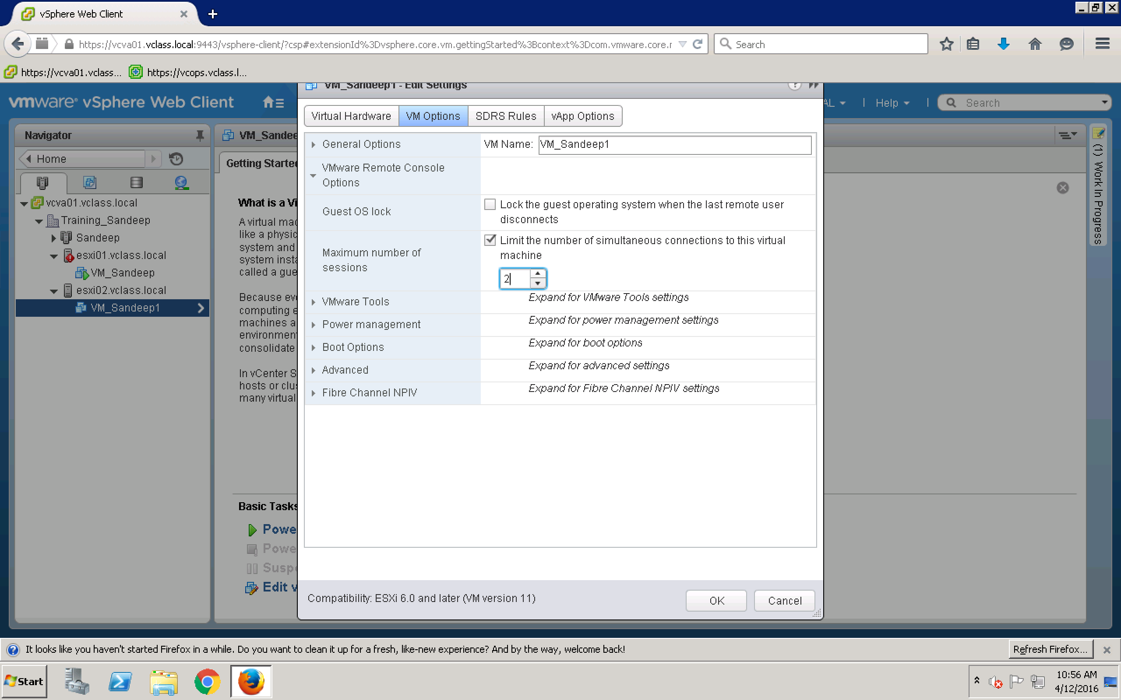

Slide 13
Updating VMware Tools Automatically
You can automate the process of upgrading VMware Tools for the virtual machines in your inventory.
You can set up Update Manager to check the VMware Tools version when a machine is rebooted. If necessary, Update Manager upgrades VMware Tools to the latest version supported by the host on which the virtual machine runs.
When you perform a VMware Tools upgrade on power cycle, Update Manager does not take a snapshot of the virtual machine and you cannot roll back to the previous version of the virtual machine.

Slide 14
Enabling Virtual Machine Logging
You can enable logging to collect log files to help troubleshoot problems with your virtual machine.
ESXi hosts store virtual machine log files in the same directory as the virtual machine's configuration files. By default, the log file name is vmware.log. Archived log files are stored as vmware-n.log, where n is a number in sequential order beginning with 1.

